Slide 1




HIVE INCUBATOR PROGRAM
Your guide to navigating and building global businesses!

Slide 2


HIVE INCUBATOR PROGRAM
WEEK 10 SESSION DECK
Operations and Scaling
BUILDING STRUCTURE FOR SCALE
Presented by
April 2025

Slide 3

Learning Agenda
Understand effective organization structure.
Standard Operating Procedures (SOPs)
Understanding Growth Strategy

Slide 4
Understand Effective Organization Structure.
Key Elements of Organizational Structure
An organizational structure is a system that defines how certain activities (such as task allocation, coordination, and supervision) are directed toward achieving business goals. It outlines roles, responsibilities, and the reporting hierarchy within a company.
In a startup, it’s important to have a flexible yet structured organization that can grow with the company.
Hierarchy: The levels of management in the business, from executives to operational staff. It outlines who reports to whom.
Roles and Responsibilities: Defines who does what within the company, ensuring clarity and accountability.
Decision-Making Process: Describes how decisions are made—whether centralized (by a few leaders) or decentralized (spread across departments or teams).
Communication Flow: How information is shared across different levels of the organization. This can be vertical (top-down or bottom-up) or horizontal (across teams or departments).

Slide 5
Types of Organizational Structures
Functional Structure
Flat Structure
Matrix Structure
Divisional Structure
This structure divides the company based on specific functions (e.g., marketing, sales, finance, product development).
It is best for startups with clear and specialized functions
This minimal hierarchy, with few or no levels between leadership and staff.
It is best for early-stage startups with small teams.
In this structure, employees report to multiple managers, usually both functional and project-based.
It is best for startups with multiple products or projects requiring cross-functional collaboration.
This structure organizes the company into semi-autonomous divisions based on products, markets, or geographical locations.
It is best for startups expanding into different markets or launching multiple products.

Slide 6
Steps-by-Steps on Designing Organizational Structure
1. Identify Your Startup’s Needs
Consider your current team size, goals, and operational needs.
Question to Ask:
What are the key functions we need to operate (e.g., sales, marketing, development)?
2. Define Key Roles and Responsibilities
Write down the essential roles that your business requires. For early-stage startups, these may overlap.
Question to Ask:
Who is responsible for critical tasks, and who do they report to?
3. Choose an Organizational Structure
Based on your startup’s size and needs, select a structure (e.g., functional, flat, matrix).
Question to Ask:
What structure helps us work efficiently today and can scale as we grow?
4. Create a Clear Reporting Hierarchy:
Make sure everyone knows who they report to, to ensure accountability and smooth decision-making.
Question to Ask:
Does each team member understand their role and who they report to?
5. Communicate the Structure to Your Team
Share the structure with your team to ensure transparency and reduce confusion.

Slide 7

ACTIVITY
Design an organizational structure based on the stage of your business

Slide 8
Standard operating Procedures
Why SOPs Are Important
A Standard Operating Procedure (SOP) is a step-by-step document that outlines how specific tasks or processes should be carried out to ensure consistency and efficiency. It acts as a guide for employees to follow so that tasks are performed in a standardized way.
SOPs provide the policies, processes and standards needed for an organization to succeed. They reduce errors, increase efficiency and enhance profitability. They also create a safe work environment and produce guidelines for how to resolve issues and overcome obstacles.
Consistency: Ensures that processes are carried out the same way each time, reducing errors and variability.
Efficiency: Helps streamline operations, reducing wasted time and resources.
Training: New employees can quickly learn how to carry out tasks by following clear procedures.
Scalability: As the startup grows, SOPs help maintain quality and performance, even as the team expands.

Slide 9
Steps to Create an SOP
1. Identify Key Processes
Start by identifying the critical processes in your business that need SOPs. Prioritize processes that are repeated often, involve multiple team members, or are prone to errors (e.g., product assembly, customer onboarding, inventory management).
2. Break Down the Process
Outline the process from start to finish. Write down each step involved in the process in the order it happens. Be detailed, but avoid overcomplicating it.
3. Assign Responsibilities
Clearly define who is responsible for each step. This ensures accountability and prevents confusion.
4. Test the SOP
Before finalizing the SOP, test it with the team to ensure it is easy to follow and effective. If there are gaps or ambiguities, revise the SOP accordingly.
5. Document and Share
Once finalized, store the SOP in a shared location (e.g., a cloud-based platform) where all team members can access it. Make sure everyone knows where to find it.
6. Review Regularly
Set a schedule to review and update SOPs regularly, especially when there are changes in the business, new technology, or process improvements.

Slide 10
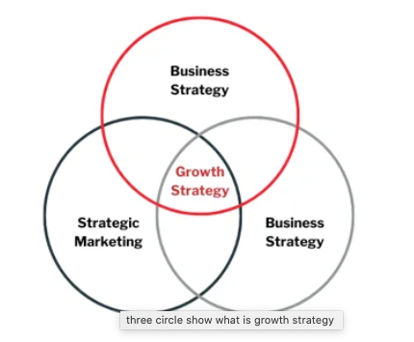
Growth Strategy
Growth strategies help startups scale their business, attract customers, increase revenue, and expand market share.
There are two primary types of growth strategies:
Organic Growth: Growing your business by improving existing operations, expanding your customer base, or introducing new products or services.
Inorganic Growth: Growing your business through mergers, acquisitions, or partnerships with other companies.

Slide 11
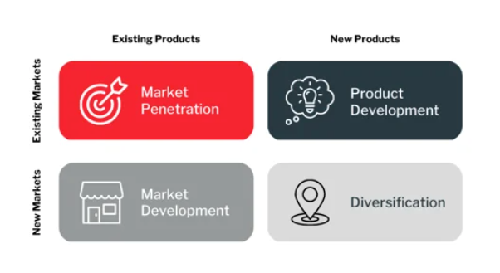
Ansoff Matrix (Growth Strategy)
Market Penetration is considered a low-risk strategy. A company using market penetration will attempt to expand the sales volume of its current products in its already established markets to increase its total market share.
Market Development is a high-risk strategy that can yield significant returns. It should only be considered when you possess enough capital and resources. Market development is about expanding or retargeting.
Product development is a strategic approach to growth that creates and commercializes new products. Instead of increasing market share, it improves your product line to attract more clients in your existing market segment.
Diversification is the riskiest of the four growth options. This strategy involves introducing a new product into an entirely new market, where you may need more experience. This could include deploying products in new geographic areas and translating the benefits of your products to the local population.

Slide 12
Connecting growth strategy to your growth marketing
3. Implementation
Executing your marketing strategy starts with identifying how and where you will place your message that will be most effective for generating leads or driving sales.
4. Evaluation
With your campaign complete and your strategy reaching the end of its cycle, it's time to analyze your results against your original KPIs, individual channel performance KPIs, and growth goals.
6. Review Regularly
Set a schedule to review and update SOPs regularly, especially when there are changes in the business, new technology, or process improvements.
1. Strategy
Develop and define the unique qualities that differentiate you from your competitors, emphasizing the most relevant customer segments and how your product's unique attributes best meet their needs.
2. Landscape
Conducting research on the state of your industry and competitor analysis is the best way to determine if your desired marketing growth strategy is necessary and feasible. Understanding your competitor set within the marketing context allows you to differentiate your products and services in a similar customer segment.

Slide 13
KEY TAKEAWAYS
The key practical work from this module is to develop
STANDARD OPERATING PROCEDURE (SOP)
The take-home activity should be done before your coaching session. A workbook is included to guide you.

Slide 14
TAKE HOME ACTIVITY
Develop a Standard Operating Procedure (SOP) for a major process in your business

Slide 15
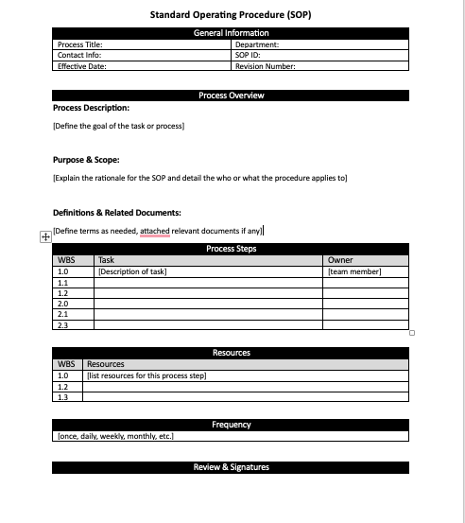
Standard Operating Precedure Workbook

